Slide 1
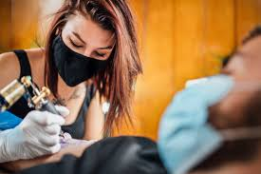
This week’s career of the week is…..
Tattoo Artist

Slide 2
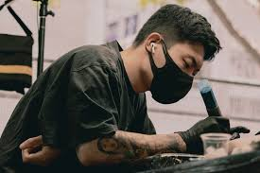
What is it??
Tattooists create permanent artwork on their clients' bodies, by design the tattoo themselves according to the client’s wishes and then using a needle to draw the design onto the customer’s skin.
As a tattooist you'll:
advise clients on suitable tattoos
make sure the chosen design is exactly what the client wants
check that clients understand that the tattoo is permanent
copy the chosen design onto the customer's skin, either by drawing freehand or using a transfer
follow the design lines with an electrically-operated needle, which injects ink under the skin
make sure all equipment is sterilised and clean
follow strict hygiene and health and safety procedures

Slide 3
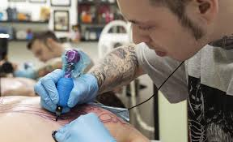
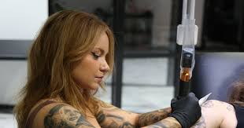
Where could I work?
You could work in a studio or at a store. There are tattoo studios all over the UK.

Slide 4
How Much Could I Earn?
The average salary for a tattooist in the UK is £39, 400
Usually you would be working between 30 and 40 hours per week, weekdays, evenings and weekends as required by the customer.

Slide 5
How would I become a tattoo artist?
You could start as an assistant or an apprentice in a tattoo studio. You would need to find a registered tattooist who is willing to take you on and train you.
You would learn alongside them in the workplace to get the skills, knowledge and experience needed for the job.
For tattooing, you'll need:
an interest in tattooing designs
artistic ability
a portfolio of your own artwork and design ideas to showcase your talents
You might have to start as a customer service assistant in a studio, answering enquiries and booking appointments. From there, you could look out for trainee opportunities.

Slide 6
Other routes into the career
You could take short training courses and distance learning courses. These will not make you fully qualified. You'll also need to get hands-on, supervised experience in a registered studio.
Many tattooists have experience or qualifications in art and design. It can be useful to have a portfolio of your work.
It's useful to know about the styles and history of tattooing across different cultures. This can help you understand the traditions and meaning of images and how they are meant to be used.
Networking is a good way to get your skills known. Look for online community forums that can put you in touch with experienced tattooists

Slide 7
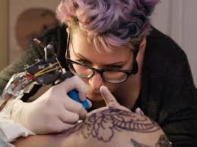
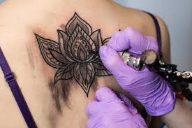
So what do tattoo artists do?
https://www.youtube.com/watch?v=l9nS4OhBeq4

