Slide 1
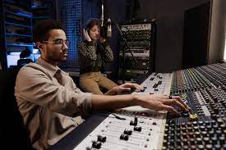
This week’s career of the week is…..
Audio/ Sound Technician

Slide 2
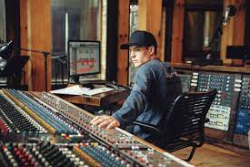
What is it??
Alternative titles for this job include
Production sound mixer, sound recordist, TV or film sound technician
Sound technicians are responsible for recording the voices and background noise on TV and film shoots, or controlling the audio in a theatre or musical events.

Slide 3
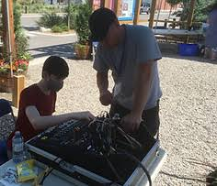
Where could I work?
A sound engineer spends most of their time in a recording studio, maintaining the sound booth equipment, but a live audio engineer is able to leave the production room and enter into the world of live venues. They help live performances sound their best, or be involved in the audio on films, TV, music videos, music festivals, concerts and theatres.

Slide 4
How Much Could I Earn?
Typical salary starts at £21, 000
This can increase to £45, 000 per year for more experienced workers.
Usually you would be working between 42 and 50 hours per week.

Slide 5
What qualifications would I need?
You could go to university or one of the Wiltshire College and University Centres and do a foundation degree, higher national diploma or degree in:
sound engineering
music technology
media technology
electrical or electronic engineering
You'll usually need:
1 or 2 A levels, or equivalent, for a foundation degree or higher national diploma. This qualification takes 2 years.
2 to 3 A levels, or equivalent, for a degree- a degree takes 3 years to complete

Slide 6
Or you could study at college
You could take a college course to develop your knowledge and skills before looking for a job. Courses include:
Level 2 Certificate in Music Technology
Level 3 Extended Certificate in Sound Engineering
Level 3 Extended Diploma in Creative Digital Media Production
T Level in Media, Broadcast and Production
You may need:
2 or more GCSEs at grades 9 to 3 for a level 2 course
4 or 5 GCSEs at grades 9 to 4 for a level 3 course
4 or 5 GCSEs at grades 9 to 4, including English and maths for a T Level

Slide 7
Or you could do an apprenticeship and earn while you learn
You could start training in this job by applying for an apprenticeship that covers sound engineering skills. Apprenticeships include:
Creative Industries Production Technician Level 3
Broadcast and Media Systems Technical Operator Level 3
Audio Visual Technician Level 5
You'll usually need:
5 GCSEs at grades 9 to 4, including English and maths, for an advanced apprenticeship
4 or 5 GCSEs at grades 9 to 4 and A levels, or equivalent, for a higher or degree apprenticeship

Slide 8
Or
It's possible to start out as a roadie, loading and unloading sound equipment, and setting it up. You may then be able to learn some of the skills you need from experienced sound technicians.

Slide 9
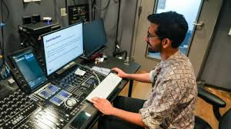
So what do sound technicians do?
https://www.youtube.com/watch?v=pua9iXBFCCs

