Slide 1
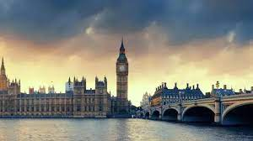
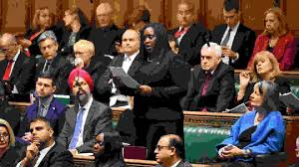
This week’s career of the week is…..
MP

Slide 2
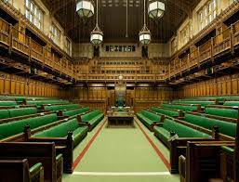
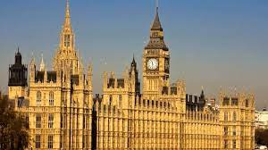
What is it??
Sometimes also called Member of Parliament, elected representative, constituency representative, politician
MPs represent people's concerns and interests in the House of Commons.

Slide 3
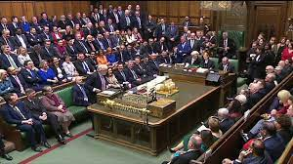
Where could I work?
As an MP, you'll attend sessions in Parliament to:
vote on new laws and policies
raise constituents’ concerns with ministers
debate issues and ask questions
Outside Parliament, you'll:
talk to businesses and schools about local, national and international issues
speak to the media
attend meetings and conferences
hold advice sessions in your constituency

Slide 4
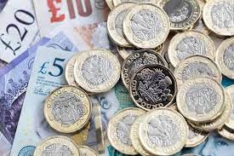
How Much Could I Earn?
Typical salary starts at £87,000
This can increase to £104, 000 per year.
Usually you would be working between 44 and 46 hours per week, sometimes at the weekend and sometimes away from home.

Slide 5
How do people become MPs?
You can get into this job by being elected by voters in the constituency (area) you wish to represent.
Volunteering is a really good way to start- most people show their commitment through campaigning and volunteering for the political party who they wish to work for.
You could also
get involved in student politics
Or work as a researcher or caseworker for an existing MP

Slide 6
Elections
To become an MP, you have to be elected in a byelection or general election. We are having a general election on 4th July- they usually take place about every 5 years and the results of the general election determine which political party will be in power until the next general election. You can stand for election as a member of a political party (like the Conservatives, Labour, Liberal Democrats, Green Party to name a few) or as an independent candidate.
Each political party has its own selection procedure. Usually, you'll need to get the support of your party's nominating officer before you can become a candidate.
During an election, you'll be expected to campaign in public and online, attend meetings, make speeches and talk to the local media. You'll find it helpful to have some experience in one or more of these areas.

Slide 7
Career Tips
You'll need a good understanding of local and national issues, and keep up to date with current affairs.
The Houses of Parliament offer the following schemes to get involved:
Parliamentary Academy Scheme
Speaker's Parliamentary Placement Scheme
House of Commons Apprenticeship Scheme
House of Lords Apprenticeship Scheme
Undergraduate Sandwich Student Placements

Slide 8
Restrictions and requirements
You'll need to:
be over 18 years of age
be a UK, Republic of Ireland or Commonwealth citizen
To stand for election, you'll need to be nominated by at least 10 electors from the constituency you wish to represent. You also need to pay a £500 deposit which you get back if you get more than 5% of the total votes in your constituency.

Slide 9
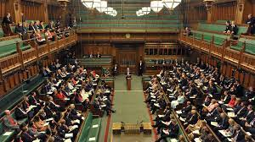
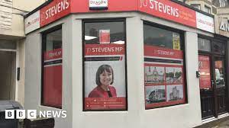
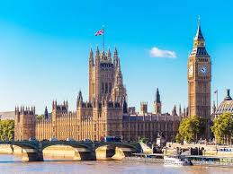
So what do do?
https://www.youtube.com/watch?v=6mXYbxtmzNU

