Slide 1
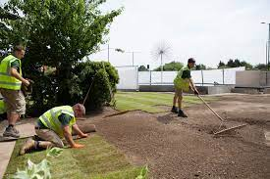
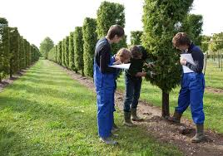
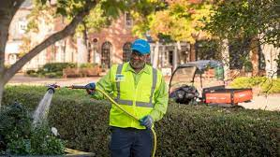
This week’s career of the week is…..
Landscaper

Slide 2
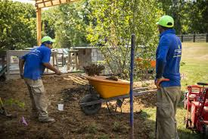
What is it??
Landscapers (or landscape gardeners) create and maintain gardens, parks and other outdoor areas.
As a landscaper, you could:
prepare sites for landscaping, using tools and machinery
work from a plan made by a garden designer or landscape architect
plant flowers, shrubs and trees, order supplies and sow lawns
build paths, walls, water features and rock gardens
advise clients on how to look after their green spaces

Slide 3
Where could I work?
You could work in a garden, at a client's business, at a client's home or at a garden centre.

Slide 4
How Much Could I Earn?
Typical salary starts at £20, 000
This can increase to £26, 000 per year for more experienced workers.
Usually you would be working between 38 and 42 hours per week, including weekends.

Slide 5
How do I get a job as a landscaper?
You can get into this job through:
a college course
an apprenticeship
working towards this role
applying directly
a specialist training course

Slide 6
You could study at college
You could take a college course to get some of the skills you might need as a landscaper. For example:
practical horticulture
landscape construction
T Level in Agriculture, Land Management and Production
Entry requirements for these courses vary.
4 or 5 GCSEs at grades 9 to 4 including English and maths for a T Level

Slide 7
Or you could do an apprenticeship and earn while you learn
You could apply to do an apprenticeship, such as:
Horticulture or Landscape Construction Operative Level 2 Intermediate Apprenticeship
Landscape or Horticulture Supervisor Level 3 Advanced Apprenticeship
These take between 2 and 3 years to complete.
Entry requirements
some GCSEs, usually including English and maths, or equivalent, for an intermediate apprenticeship
5 GCSEs at grades 9 to 4 including English and maths, for an advanced apprenticeship

Slide 8
Or
You could start as an assistant landscaper with a company and work your way up through training and promotion.

Slide 9
Skills and Knowledge That You Will Need
to be thorough and pay attention to detail
the ability to work well with others
physical skills like lifting, bending and carrying
customer service skills
ambition and a desire to succeed
physical fitness and endurance
the ability to work well with your hands
patience and the ability to remain calm in stressful situations
to be able to carry out basic tasks on a computer or hand-held device
What you’ll do

Slide 10
So what do landscapers do?
https://www.youtube.com/watch?v=ZNFAcNsB5Yo

