Slide 1
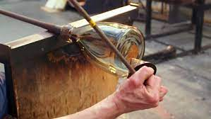
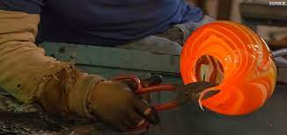
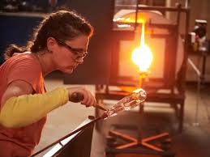
This week’s career of the week is…..
Glassmaker

Slide 2
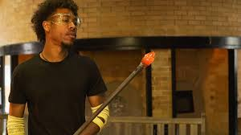
What is it??
Craft glassmakers design, make and decorate glass objects from windows, mirrors and tableware to one-off decorative pieces. Glassmakers use a variety of techniques to prepare and shape their glass and create objects ranging from simple shapes, to complex sculptures.

Slide 3
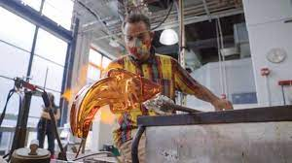
Where could I work?
You could set up your own business with your own creative studio or work alongside other artists as part of a creative community.
With experience and further qualifications you could teach students and apprentices in colleges or universities.
There are glassmakers all over the country- the nearest one is in Andover!

Slide 4
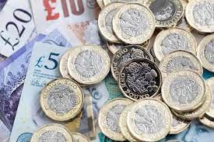
How Much Could I Earn?
Salaries for glass blowers can start from £16,000, rising to between £18,000 and £25,000. Experienced designers, or those working for larger companies, can earn more than £35,000

Slide 5
What qualifications would I need?
Most craft glassmakers have a foundation degree, higher national diploma or degree in a subject like:
art and design
fine art
ceramics and glass
architectural crafts
You'll need a portfolio of work to show when applying for courses.
Entry requirements:
1 or 2 A levels, or equivalent, for a foundation degree or higher national diploma
2 to 3 A levels, or equivalent, for a degree
To study A-Levels you normally need 5 or more GCSE’s at grade 4+ including English and Maths.

Slide 6
Or you could study at college
Some colleges run short creative craft courses in glass, which may be useful for picking up glassmaking skills and techniques.
There are also glass manufacturing courses, which would teach you some of the skills and knowledge you need to get into glass making in industry. These include:
Level 2 Certificate or Level 3 Diploma in Glass Processing
Level 2 or Level 3 Certificate in Glass Related Operations
Entry requirements:
2 or more GCSEs at grades 3+ for a level 2 course
4 or 5 GCSEs at grades 4+ for a level 3 course

Slide 7
Or you could do an apprenticeship and earn while you learn
You could specialise in stained glass making through a stained glass craftsperson higher apprenticeship.
This would typically take 36 months to complete as a mix of workplace learning and off-the-job study.
Entry requirements:
4 or 5 GCSEs at grades 4+ and A levels, or equivalent, for a higher or degree apprenticeship

Slide 8
Some of the things you might do as a Glassmaker
design new, one-off pieces or ranges of glass items
mix different ingredients and additives
blow glass using a blowing iron
form and bend glass using heat or moulds
cut, grind and fix pieces of glass together using soldering or fusing techniques
decorate glass items using laser, point, stipple, drill, copper wheel or sand engraving
etch items using acid or make patterns using stencils
use tools and machinery like lathes and sandblasters
repair or conserve existing glass items like stained glass panels, windows or mirrors
if you are self-employed, market your business and do admin tasks

Slide 9
Career Prospects
Some glassmakers specialise in making glass for art.
Some glassmakers make or repair glass windows.
Some make glass for a very specific purpose such as to use in science or healthcare.
It is predicted that there will be a 14% increase in the number of jobs for glassmakers over this decade.

Slide 10
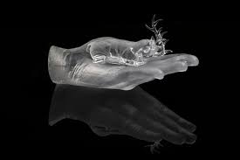
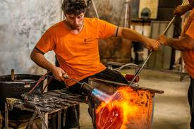
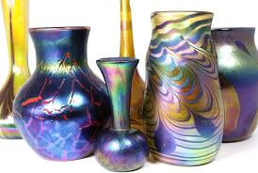
So what do glassmakers do?
https://www.youtube.com/watch?v=bhYWtWuCcng

