Slide 1
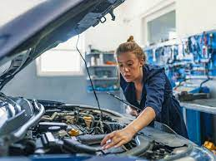
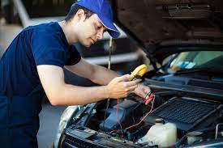
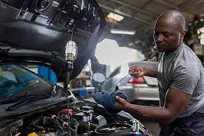
This week’s career of the week is…..
Motor Mechanic

Slide 2
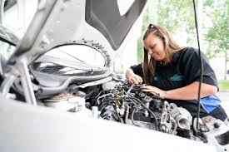
What is it?? Motor mechanics repair and service cars and vans. As a motor mechanic, you could: find and diagnose faults using hand tools or a computer. advise customers on what repairs are needed, including cost, repair or replace faulty parts and carry out regular maintenance.

Slide 3
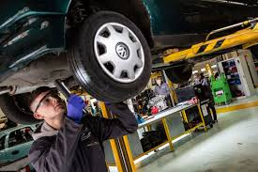
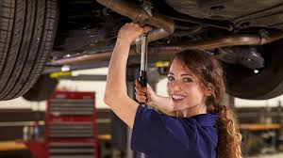
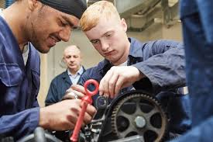
Where could I work?
As a motor mechanic you would likely work at a garage. There are lots of garages around !!
Alternatively some motor mechanics who work for companies such as the AA or RAC are mobile mechanics who work at the roadside.

Slide 4
How Much Could I Earn?
Typical salary starts at £18, 000
This can increase to £35, 000 per year for more experienced workers.
Usually you would be working between 38 and 45 hours per week, mostly on a weekday although you could also have to work evenings and weekends.

Slide 5
What qualifications would I need?
You could take a college course before applying for a trainee motor mechanic role with a garage.
Relevant courses include:
Level 2 Diploma in Light Vehicle Maintenance and Repair Competence (you’ll first need 2 or more GCSE’s at grade 3-9
Level 3 Diploma in Light Vehicle Maintenance (you’ll first need 4 or 5 GCSE’s at grade 4-9)
T Level in Maintenance, Installation and Repair for Engineering and Manufacturing (you’ll first need 4 or 5 GCSE’s at grade 4-9 including English and Maths)
You could specialise in hybrid and electrical vehicles by doing a course like:
Level 3 Diploma in Auto-Electrical and Mobile Electrical Operations
Level 3 Award in Electric/Hybrid Vehicle System Repair and Replacement
For these level 3 courses you need 4 or more GCSE’s at grade 4-9.

Slide 6
Or you could do an apprenticeship
You could do an advanced motor vehicle service and maintenance technician apprenticeship.
This will usually take 2 to 3 years. You'll do on-the-job training and spend time at a college or training provider.
You could also train as a vehicle mechanic in the British Army.
You'll usually need:
some GCSEs, usually including English and maths, or equivalent, for an intermediate apprenticeship
5 GCSEs at grades 9 to 4, including English and maths, for an advanced apprenticeship

Slide 7
Or
You may be able to join a company as an trainee mechanic and do training on the job to qualify as a mechanic. It will help if you are interested in the motor industry and enjoy fixing cars. It can also be useful to have a knowledge of different makes and models.

Slide 8
What Skills and Knowledge Would You Need?
You'll need:
the ability to use, repair and maintain machines and tools
to be thorough and pay attention to detail
problem-solving skills
the ability to work well with your hands
customer service skills
the ability to work well with others
knowledge of engineering, science and technology
the ability to use your initiative
to be able to use a computer and the main software packages competently

Slide 9
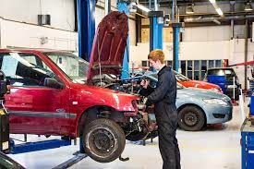
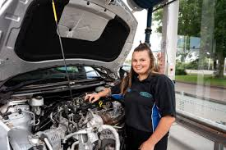
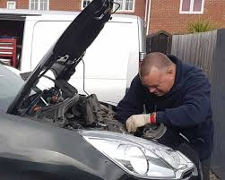
So what is it like to study to be a motor mechanic?
https://www.youtube.com/watch?v=D26DjxKi-ng

