Slide 3
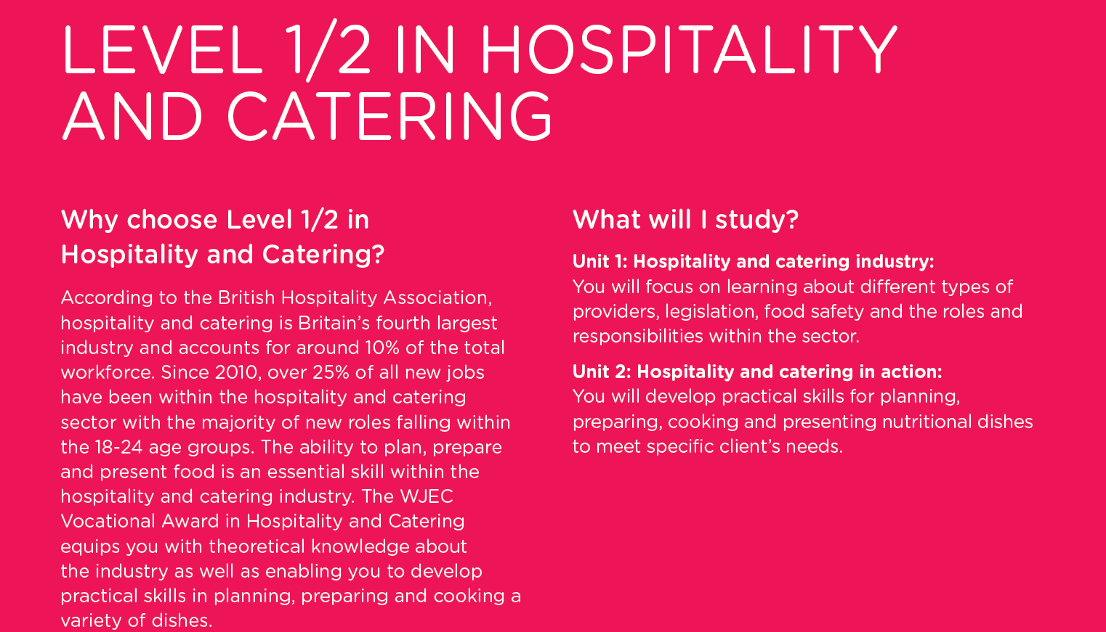

Slide 5
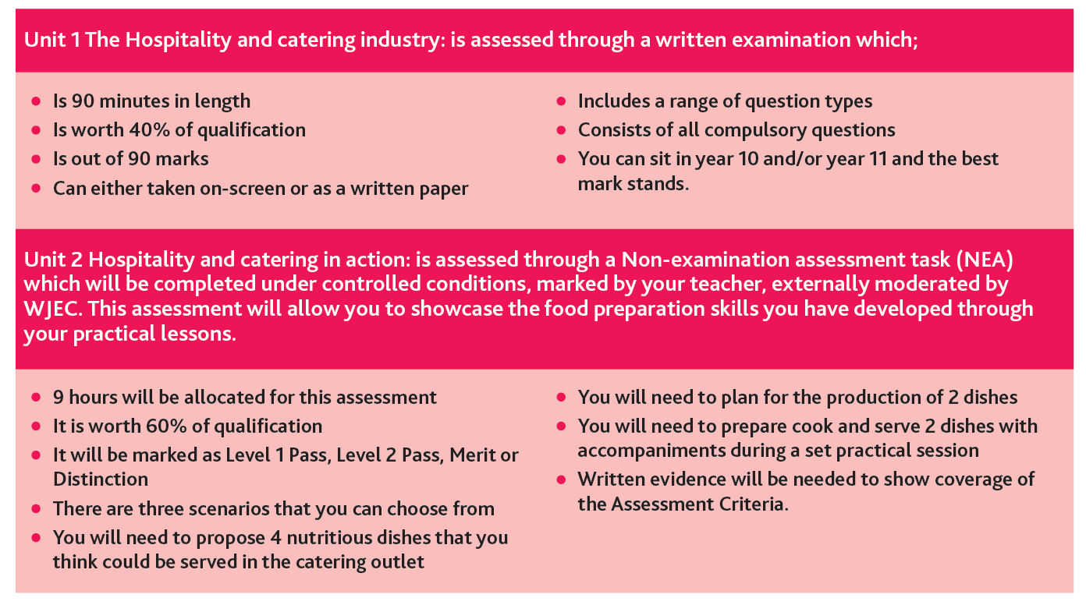

Slide 11
A Typical Year 10 Summer Homework Task 1
Look at the glossary attached and familiarise yourself with the key words and some of the subject specific terminology.

Slide 13
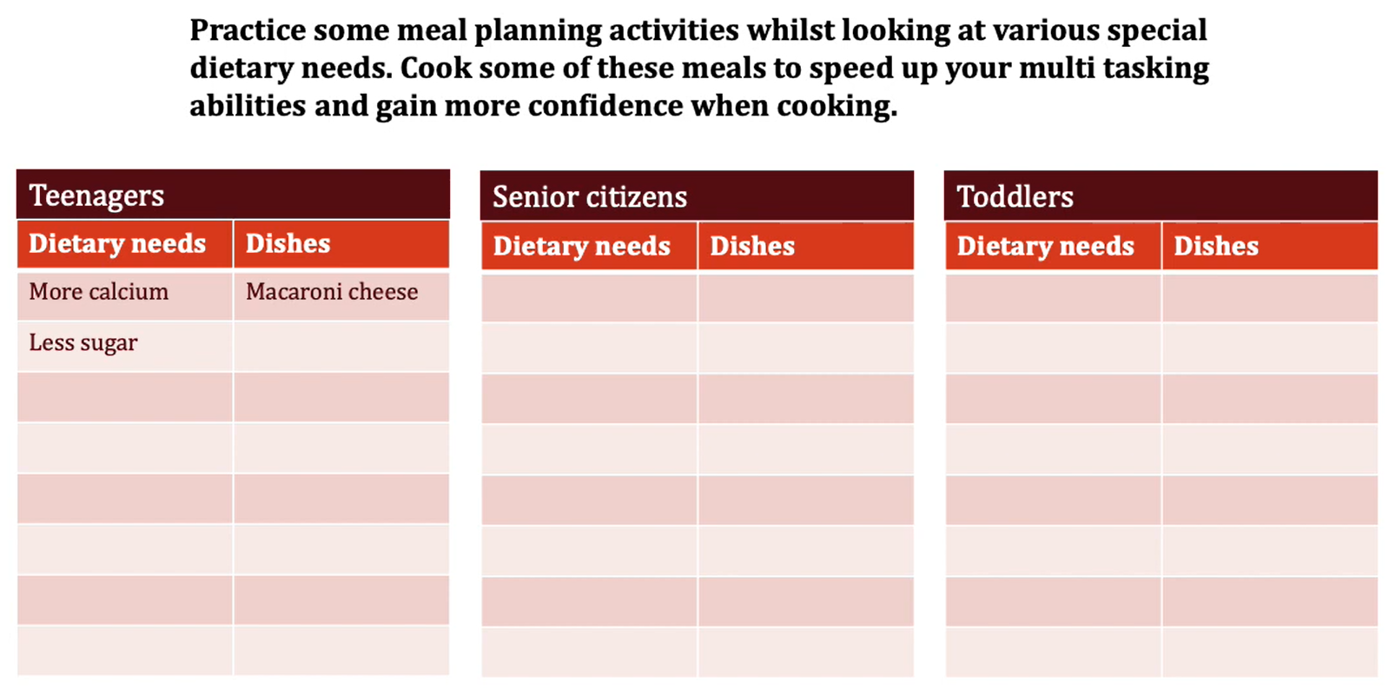
A Typical Year 10 Summer Homework Task 2

Slide 14
Links to further study at KS5 and beyond
After completing the WJEC Vocational Award in Hospitality and Catering you may be interested in progressing to other qualifications relevant to working in the sector, such as: -
WJEC Level 3 Applied Certificate/Diploma in Food Science and Nutrition
Level 2/Level 3 Diplomas in Hospitality and Catering
Level 2/Level 3 Diplomas in Professional Cooking
Level 3 Diploma in Hospitality and Tourism Management.

Slide 15
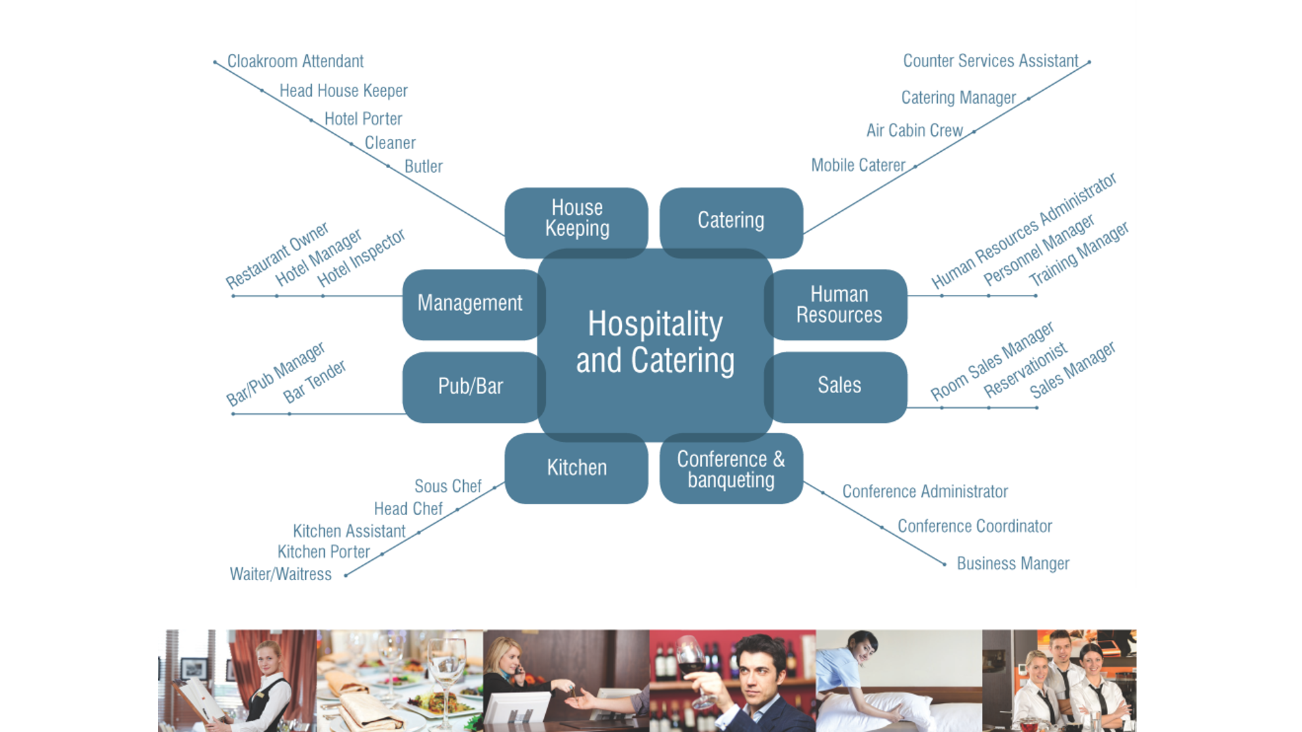
Links to future careers

Slide 16
I hope this introduction has given you a good insight into this exciting course and look forward to teaching many potentially interested students in September 2022. For further details and information regarding the course, please feel free to come and see me for an informal discussion to discuss whether or not the course is the right one for you. You will also be provided with more visual information on the Options Evening.
Mr. D. Kajoo (Teacher of Hospitality & Catering)
THANK YOU

