Slide 1
GCSE History
Miss Whitby
Mr Clarke

Slide 2
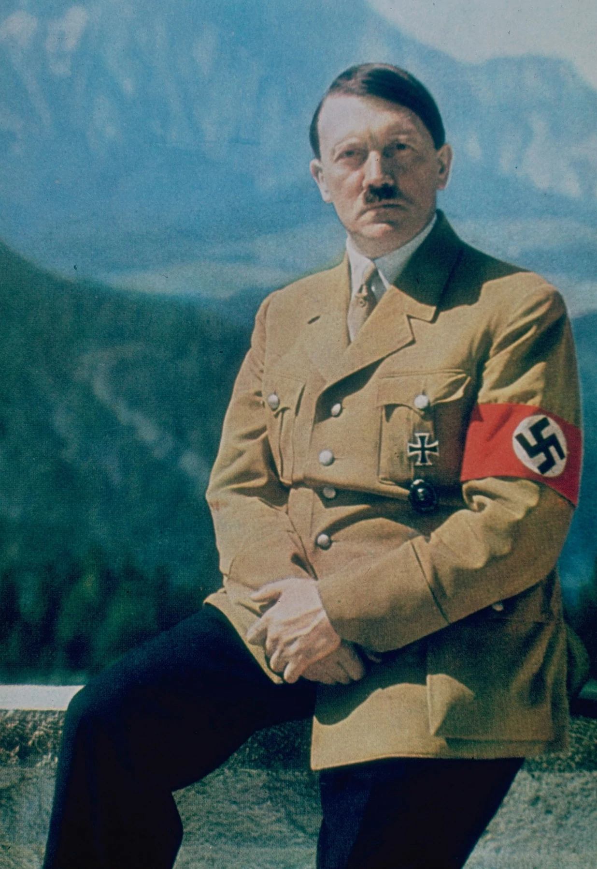
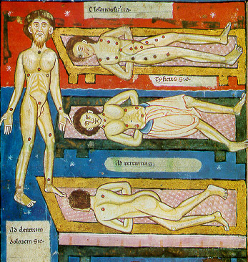
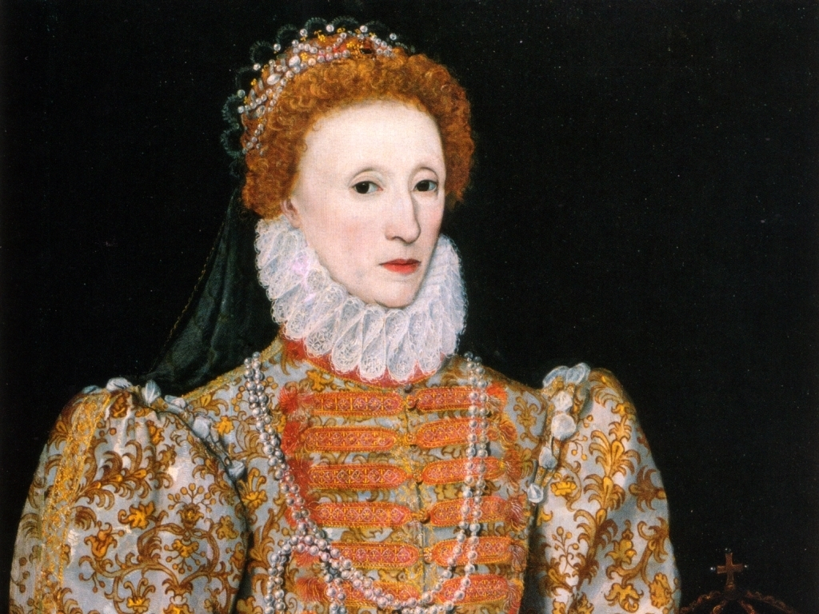
Course overview
Paper 1 | Medicine through time, 1250-present | 1.15 hrs - 30%
Paper 2 | The American West 1835 - 1895 and Elizabeth I, 1558-88 | 1.45 hrs - 40%
Paper 3 | Weimar and Nazi Germany, 1918-1939 | 1.20 hrs - 30%

Slide 3
Medicine through Time - Paper 1
This paper explores how medical knowledge, treatment and prevention has changed from the medieval period to the present day.
The time period is broken down into four periods; the medieval period (1250-1500), the Renaissance (1500-1750), the Industrial Period (1750-1900) and the modern period (1900-present).
There is also a depth study on medical treatment on the Western Front in World War One. This explores how medicine has to adapt and change in order to meet the new demands of modern warfare never seen before.

Slide 4
America West - Paper 2
The first topic studied will be the American West c.1835 – 1895.
In this topic you will study the lifestyle of Native Americans, the impact of migration and lawlessness in the West. You will then look at how the Great Plains changed and were developed through ranching and the cattle industry, and the impact on the Plains Indians’ lives of events and developments between c1862 and c1876. Finally, students look at further changes in farming, the cattle industry and settlement, conflict and tension between different groups living on the Plains, and the destruction of the Plains Indians’ way of life.

Slide 5
Early Elizabethan England - Paper 2
This covers the early reign of Elizabeth I from her ascension as Queen of England in 1558 to the Spanish Armada in 1588.
Although Elizabeth I is remembered as one of England’s most successful monarchs, the beginning of her reign was beset with threats. Students will learn how Elizabeth was able to navigate through the religious rivalry and uncertainty between Catholics and Protestants, foil the many Catholic plots to assassinate her and the threat of a Spanish invasion. The last unit explores Elizabethan society and exploration to consider whether Elizabethan England was a ‘golden age’ in our history.

Slide 6
Weimar and Nazi Germany - Paper 3
This paper covers post-war Germany and how Hitler and the Nazi party were able to come to power in 1933 and take Germany to war in 1939.
After World War One Germany was in ruins and needed rebuilding. A new democracy was set up in Germany, however, it was beset with rebellions and uprisings from the beginning. Students will learn how Germany was able to recover in the 1920s but ultimately fail due the Great Depression of the 1930s.
The second half of the course explores the rise of the Nazis and the transformation of Germany into a one party dictatorship under Hitler. This covers life under the Nazis, the terror state and the persecution of minority groups in Germany.

Slide 7
Skills
Knowledge and understanding - ability to process information to explain why things happened and the consequences
Evaluation and judgement - ability to identify and justify the importance of different events
Source evaluation - ability to analyse sources and place them in their historical context
Literacy and written communication - History requires a high standard of written communication. The exam papers all require extended writing and is vital to achieve high grades at GCSE.

