Slide 1
This week’s career of the week is…..
Psychologist

Slide 2
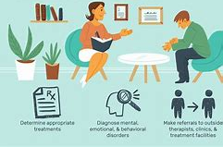
What is it??
Psychologists provide therapeutic support to individuals. They work to reduce psychological distress and promote the wellbeing of individuals, groups and families. They treat people by examining their experiences and exploring underlying issues, as well as looking at their current life. They treat a wide range of mental health concerns, from depression and anxiety to psychosis and personality disorders. They also can help with bereavement, abuse, trauma, or relationship issues.

Slide 3
Where could I work?
There are many areas where psychologists can work. You may work with individuals, couples, families, with groups or at community level. You could work within the NHS in mental health services, GPs, hospitals, or other health settings. You could also work privately in private hospitals, private practice, prisons or probation, social services, sports or education.

Slide 4
How Much Could I Earn?
Entry-level salaries for trainees within the NHS range from £35,392 to £42,618.
After qualification, salaries range from £43,742 to £96,376.
Psychologists in the private sector often earn a similar level of pay.

Slide 5
What qualifications would I need?
To become a counselling psychologist, you will need to have a psychology degree accredited by the British Psychological Society (BPS).
You will then have to complete a counselling psychology doctorate course, alongside carrying out some relevant work experience and basic counselling training.
Instead of a doctorate, you can complete a Qualification in Counselling Psychology where you train as a trainee.
Upon completion, you can then register on the Health & Care Professions Council register. This shows that you are a recognised and accredited counselling psychologist.

Slide 6
What Skills Would I Need?
Good awareness of people and their behaviours.
Ability to study during continued professional development.
Ability to relate and show empathy to a wide range of people.
Excellent communication skills.
Able to work on your own as well as consult with others and work in a team.
Have a responsible, professional approach using sensitivity.
Emotional resilience and maturity.
Self-awareness, self-knowledge, security, and self-belief.
Able to work under pressure and manage time with caseloads.

Slide 7
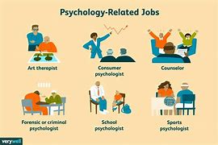
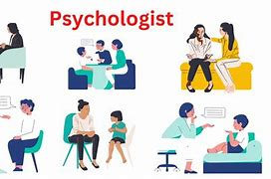
So, what do psychologists do?
https://www.youtube.com/watch?v=zYthHxlerrM

